Slide 1



UNIVERSITY INSTITUTE OF ENGINEERING
COMPUTER SCIENCE ENGINEERING
Bachelor of Engineering
Design and Analysis of Algorithms(CST-311/ITT-311)
Topic: Hashing
DISCOVER . LEARN . EMPOWER

Slide 2
Learning Objectives & Outcomes
Objective:
To understand the meaning of Hashing and its technique.
Outcome:
Student will understand
Importance of Hashing
Techniques of hashing

Slide 3
Hashing
Hashing is a well-known technique to search any particular element among several elements.
It minimizes the number of comparisons while performing the search.
An array data structure called as Hash table is used to store the data items.
Based on the hash key value, data items are inserted into the hash table.

Slide 4
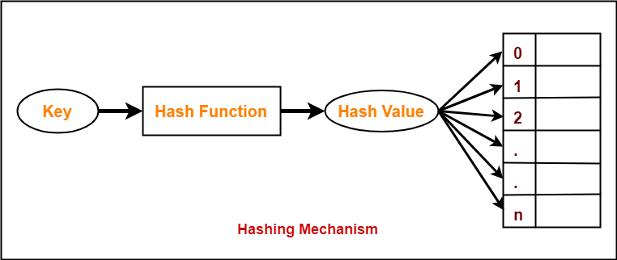
Hashing

Slide 5
Types of Hashing
Mid Square Hash Function
Division Hash Function
Folding Hash Function

Slide 6
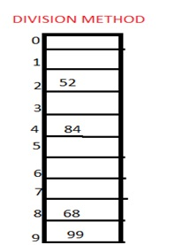
Division method
In this the hash function is dependent upon the remainder of a division. For example:-if the record 52,68,99,84 is to be placed in a hash table and let us take the table size is 10.
Then:
h(key)=record% table size. 2=52%10
8=68%10
9=99%10
4=84%10

Slide 7
Mid square method
In this method firstly key is squared and then mid part of the result is taken as the index. For example: consider that if we want to place a record of 3101 and the size of table is 1000. So 3101*3101=9616201 i.e. h (3101) = 162 (middle 3 digit)

Slide 8
Digit folding method
In this method the key is divided into separate parts and by using some simple operations these parts are combined to produce a hash key. For example: consider a record of 12465512 then it will be divided into parts i.e. 124, 655, 12. After dividing the parts combine these parts by adding it.
H(key)=124+655+12 =791

Slide 9
REFERENCES
Text books:
Cormen, Leiserson, Rivest, Stein, “Introduction to Algorithms”, Prentice Hall of India, 3rd edition 2012. problem, Graph coloring.
Horowitz, Sahni and Rajasekaran, “Fundamentals of ComputerAlgorithms”, University Press (India), 2nd edition
Websites:
https://www.gatevidyalay.com/hashing/
https://www.includehelp.com/data-structure-tutorial/hashing.aspx

Slide 10
Summary
Introduction to Hashing
  Key values
  Types of Hashing
  Mid Square Hash Function
  Division Hash Function
  Folding Hash Function

Slide 11
THANK YOU

